Slide 1
Linking College Board and Khan Academy Accounts
CHAPTER
2

Slide 2
Why Link Khan Academy and
College Board Accounts
Personalize student practice: practice recommendations on Khan Academy will be based on student’s SAT, PSAT/NMSQT®, PSAT™ 10, and PSAT™ 8/9 results.
  When students scan and score practice tests in the Daily Practice App, Khan Academy can use practice test scores to further personalize student practice.
Customize practice and recommendations: Khan Academy will use all future scores from the SAT, PSAT/NMSQT®, PSAT™ 10, and PSAT™ 8/9 to design individualized practice.
Jump right into practice and get personalized recommendations:
no additional diagnostic quizzes are needed.

Slide 3
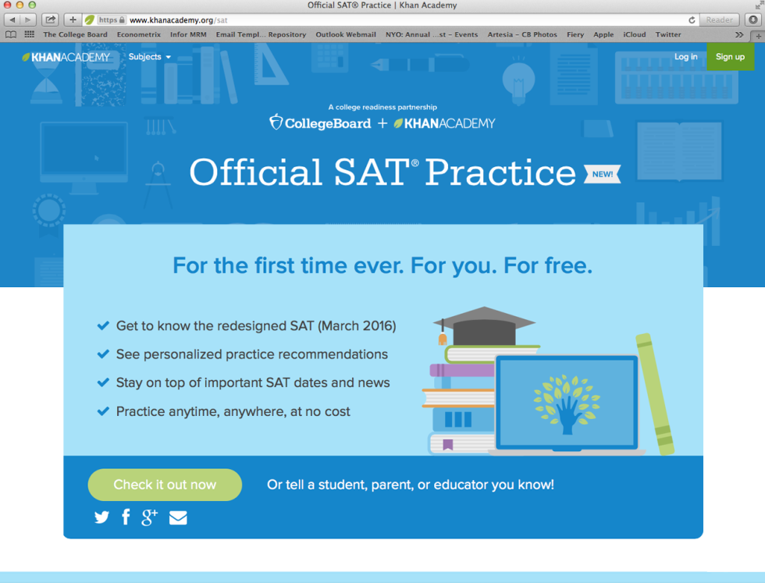
Begin at satpractice.org

Slide 4
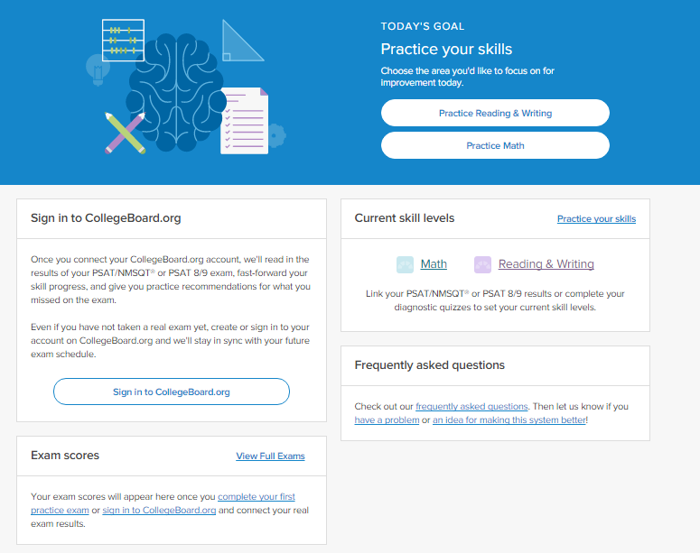
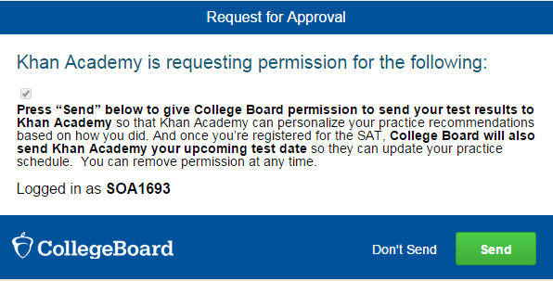
Steps to Link College Board and Khan Academy Accounts
Step 1
Log in or create a
Khan Academy account at satpractice.org
Step 2
When prompted, students can
agree to link their Khan Academy
and College Board accounts.
Step 3
Students sign in or create
a College Board account
Step 4
When prompted, students click
“Send” to authorize the account linking
Step 5
Students start practicing on
Official SAT Practice on Khan Academy!

Slide 5
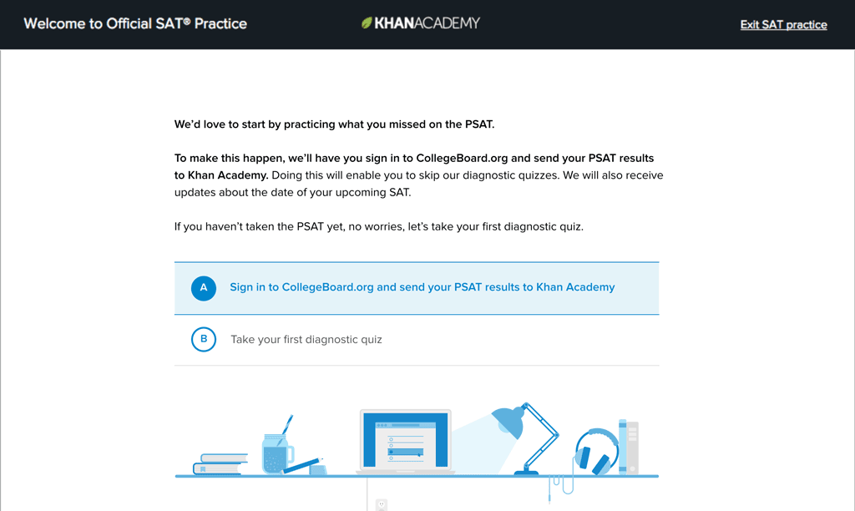

Slide 6
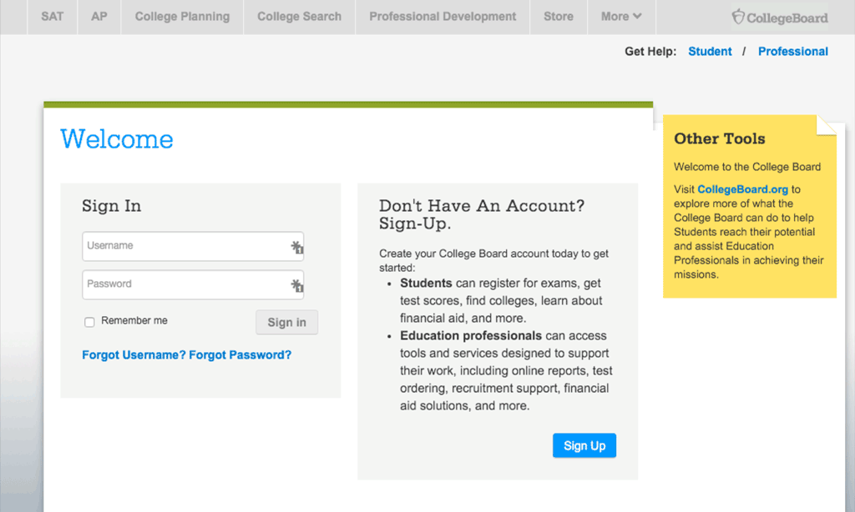

Slide 9
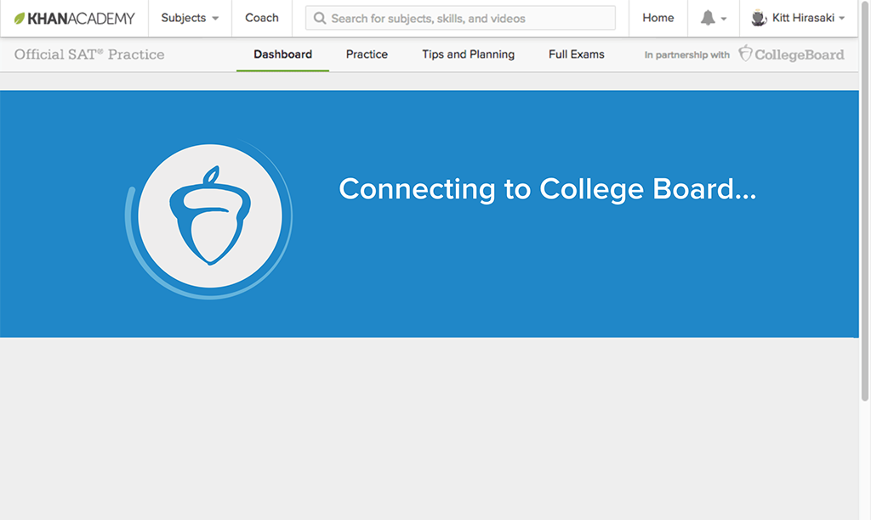

Slide 10
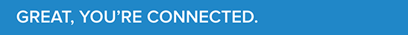

Slide 11
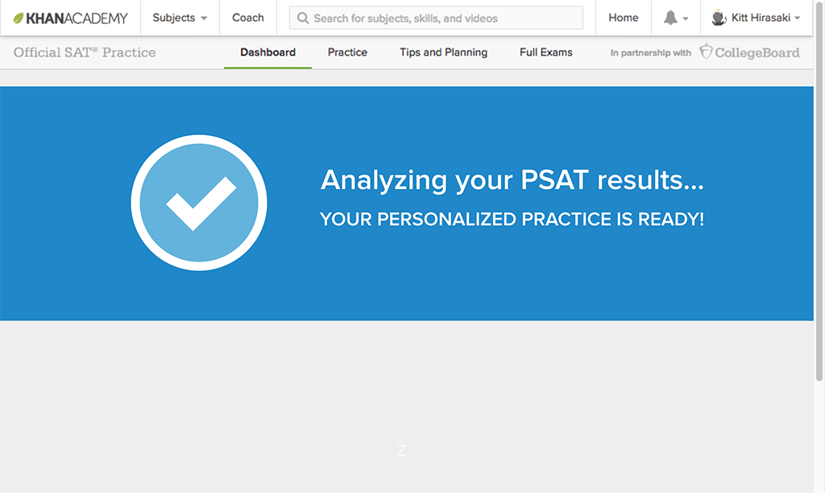
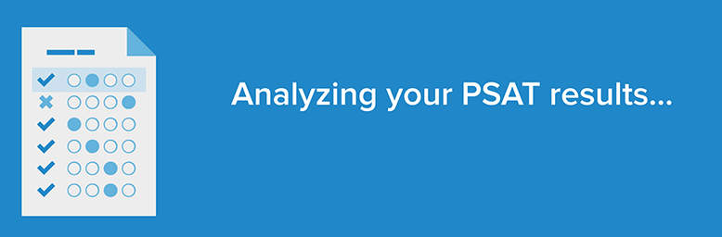

Slide 13
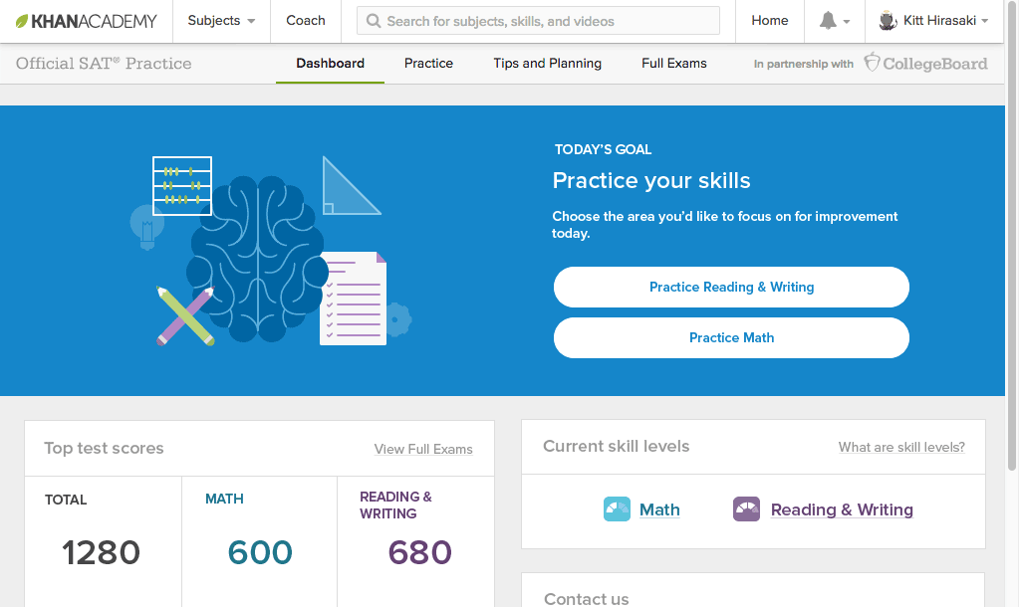

Slide 14
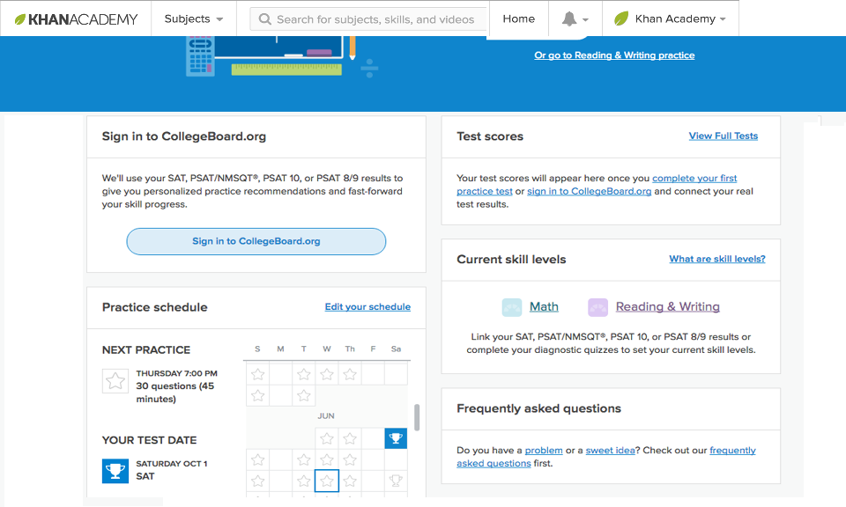

Slide 15
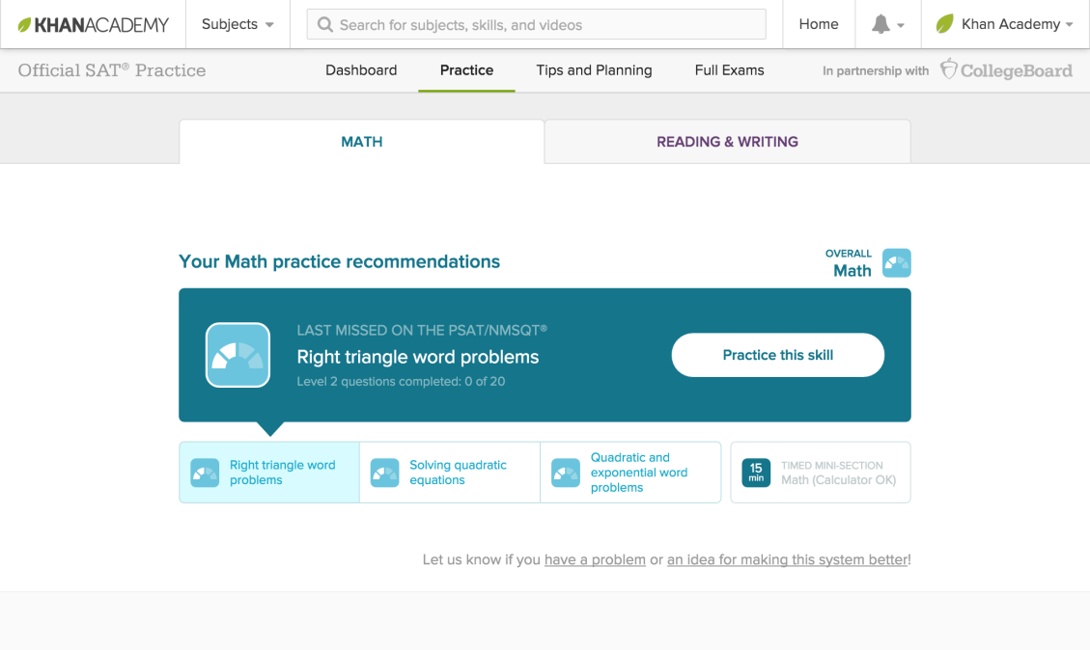

Slide 16
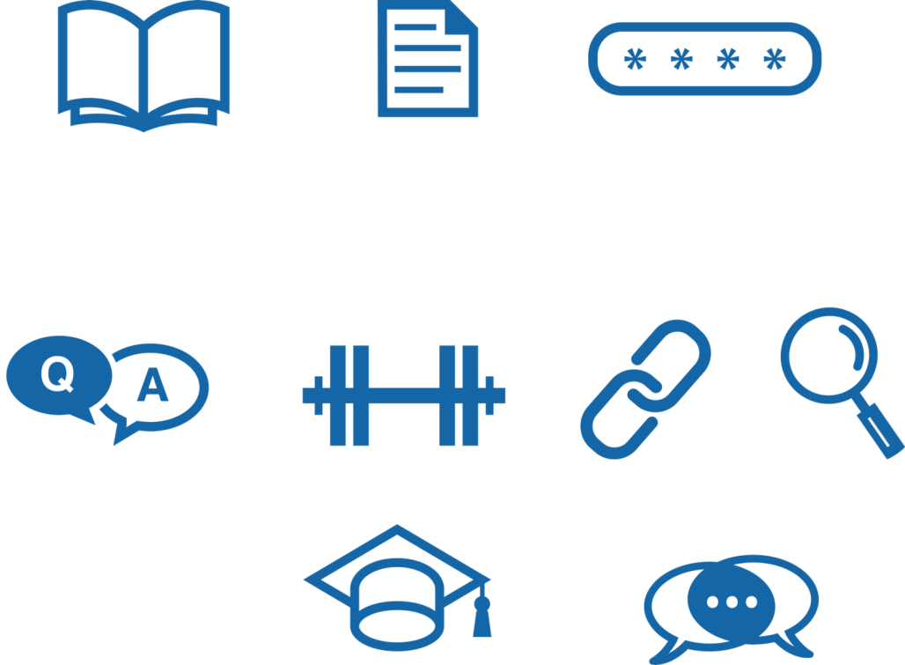
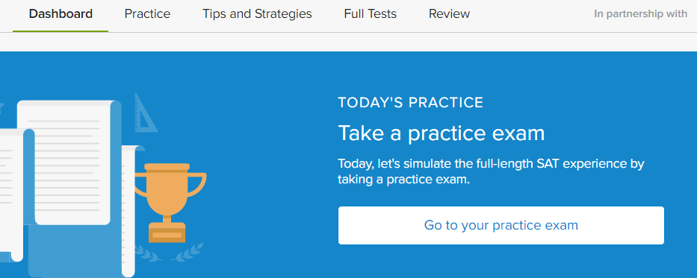
Explore Khan Academy
On your “Dashboard,” create a practice schedule
Under “Practice,” take a diagnostic quiz in Math or Reading & Writing
Watch a video in “Tips and Strategies”
Start a “Full Test” and download a paper-and-pencil version

